Slide 1
Identifying Areas for Light Rail Expansion in the Phoenix Metro Area
How can light rail better serve the citizens of Phoenix and the surrounding cities?

Slide 2
Intro and Purpose
The goal of this project was to determine areas where light rail service could be added in the near future
Areas will have higher-than-average housing density and entertainment options

Slide 3
Data Sources
US Census
Housing and census tract data
Foursquare API
Information on venues (bars, restaurants, sports, etc.)
Valley Metro
Existing and planned light rail service

Slide 4
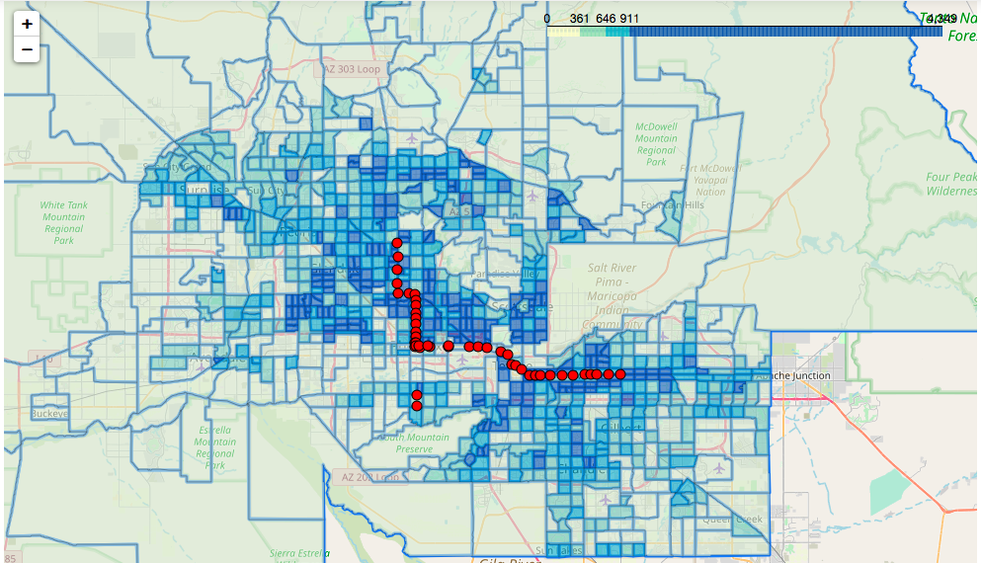
Today
Existing light rail service (red) and occupied housing density

Slide 5
Today cont.
Light rail serves dense areas, but is focused on getting commuters to downtown
Does not go neighborhood-to-neighborhood
Limited service with plans for expansion south and west

Slide 6
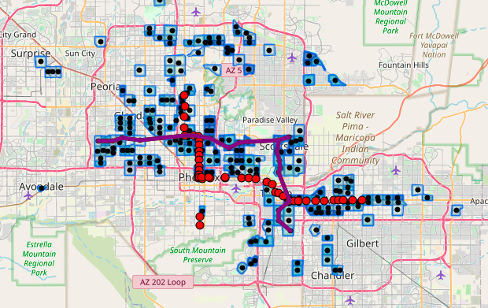
Opportunity to Grow
Proposed new lines (Maryvale to Scottsdale, Tempe to Scottsdale) in purple with walkable venue (w/in 1km) density of top 25% most densely populated census tracts

Slide 7
Conclusion
Existing light rail service is good but doesn’t serve social needs of riders – focused on downtown commuters
Venue and population density is focused in Scottsdale, Tempe, Westgate areas
New lines would offer more options for non-commuting riders and expand areas where commuters could use the light rail to get to business hubs

Slide 8
Future Research
How would new lines affect traffic?
Both on the streets they run on and in the city as a whole
Could drunk driving be reduced?
By servicing the main entertainment areas, party-goers could make trips without the need to drive

